Slide 1
UNIT - II
Building an Innovative Organization: Creativity in organizations
– Building organizational environment – Need Analysis: Questionnaires, Online tools, SWOT analysis;
Technology watch; Focus group; Desk Research – Innovation Management Process – stages of innovation
- planning and financing Innovation projects – Innovation and organization: Creating new products and services,
Exploiting open innovation and collaboration,
Use of innovation for starting a new venture;
Class Discussion- Innovation: Co-operating across networks vs. ‘go-it-alone’ approach

Slide 2
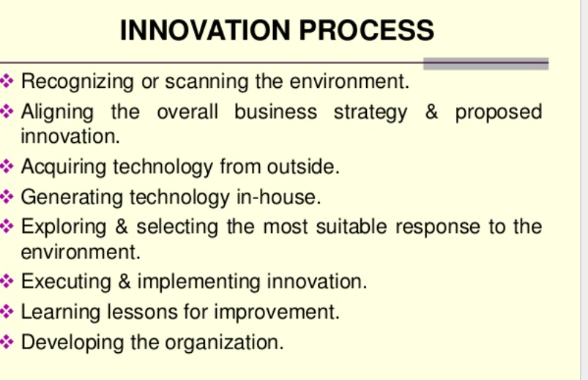

Slide 3
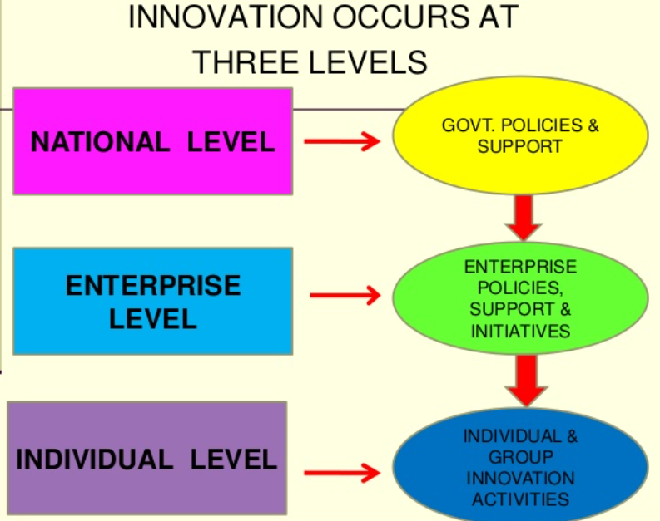

Slide 4
Stages of innovation
Regarding to the innovative process, it is possible to define key stages, as a route to achieve progresses for the innovation.
Attending to these considerations, we can draw 5 main stages in this process, summarized as follows:
Find a opportunity
Definition and redefinition of the opportunity
Idea creation (methodologies)
Idea selection
Implementation
Finding new opportunities may involve: periodic review of external and internal opportunities of the organisation, establish the proper communication channels (in order to “hear” the opportunities), develop methodologies to identify trends and insights, using of utility maps…

Slide 5
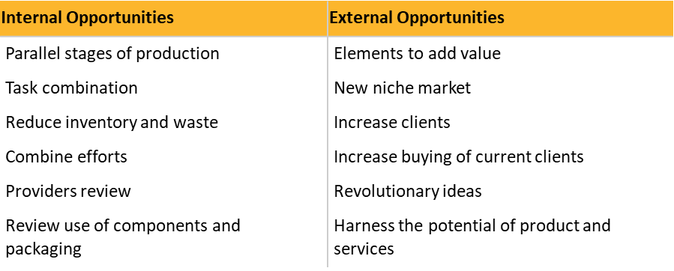

Slide 6
To redefine the opportunity, it is necessary to describe and analyze the opportunities and possibly related problems, identify limitations, develop criteria to find solutions, consider alternative options, research new specifications or carry out an exhaustive diagnosis of the opportunity (or problem).
In order to maximize the creative potential of the problem solving group, the idea generation activity should be collaborative in nature. This can be accomplished in many ways.
Idea management and innovation process management often provides collaboration tools, while facilitators of brainstorming and other ideation events should promote collaborative idea development.

Slide 7

IDEA CREATION
A good idea has a potential to develop a new product, process, service or an entirely new business.
A good idea may be a solution to a problem you have in mind.
Techniques used to create ideas:
Brainstorming
Brainwriting
Gordon’s technique
Fishbone diagram
Six thinking hats

Slide 8
BRAINSTORMING
Brainstorming involves creating an atmosphere in which people feel uninhibited and free to propose the sort of wild and improbable solutions to problems that often point to the best course of action.
Structured and unstructured:
Unstructured- encourages participants to give ideas as these come to their mind
Structured brainstorming - provides certain rules that participants must follow in order to make the gathering of inputs more orderly and evenly distributed

Slide 9
It enables to collect ideas from all team members
about a certain topic, issue, or problem in an organized manner;
encourages team members to be more creative and be open to new or non-traditional ideas;
prevents dominant team members from controlling the output of the team's idea gathering efforts;
and promotes synergy among team members by letting them
build on each other's creative thinking

Slide 10
ANALYSIS OF IDEAS
The analysis of the ideas can be done individually or in a group.
Sometimes, the group can be the same group who did the brainstorming or even better,
it can be the dedicated group of colleagues who will eventually be implementing the chosen ideas.
Because it is best to have "external" people in the brainstorming session it is often the case that the group which analyzes the ideas is a different group to that which produced them.
ideas it is always helpful to do an initial sort-out to remove duplicates and remove ideas which are really impractical.
This removal should be based on valid physical criteria such as cost, time and physical laws.
However, one should be very cautious and should not remove any remotely possible solutions at too early a stage.
The remaining ideas can be then clustered into various matrixes or groups (depending on the session’s goal).
they can be divided into the following three lists:
Excellent – definitely will work and can be implemented immediately.
Interesting – will possibly work or may require further analysis to decide if it will work.
Needs more investigating. May work in the future.
Useless – will not work.

Slide 11
Brainwriting
some/all ideas are recorded by the individual who thought of them.
They are then passed on to the next person who uses them as a trigger for their own ideas.
The method can be carried out in several different ways such as
Brain writing pool,
Brain writing 6-3-5,
Idea card method,
Brain writing game,
Constrained brain writing, etc.

Slide 12
1. Brainwriting pool
Each person, using post-it notes or small cards, writes down ideas, and places them in the centre of the table.
Everyone is free to pull out one or more of these ideas for inspiration.
Team members can create new ideas, variations or piggyback on existing ideas.
2. Brainwriting 6-3-5
The name brainwriting 6-3-5 comes from the process of having 6 people write 3 ideas in 5 minutes. Each person has a blank 6-3-5 worksheet

Slide 13
Idea card method
Each person, using post-it notes or small cards, writes down ideas, and places them next to the person on his or her right.
Each person draws a card from the neighbours’ pile as needed for inspiration.
Once the idea has been used, it is passed on to the person on the right along with any new, variations or piggybacked ideas.

Slide 14
Brainwriting game
Display the problem statement, and explain that the winner of the game is the one who devises the most unlikely solution.
The facilitator sells each group member an agreed number of blank, serially numbered cards at, say, 10 currency units each, pooling the money to form the prize. Each group member signs a receipt that records the serial numbers of their set of cards.
Members try to think of utterly implausible solutions, writing one per card. The cards are then put up on a display board.
Members now have 15 minutes to silently read all the solutions, and to append to them (on further un-numbered cards or post-its) ways in which they could be converted into a more practical way of solving the problem (so reducing that ideas’ chances of winning).
Each member then has two votes to vote for what s/he now considers to be the most improbable idea on the numbered cards. The idea that attracts most votes wins the pooled money.
Form two sub-groups, give half the cards to each, and give each group 15 minutes to develop six viable solutions from their cards.
Each sub-group tries to “sell” their ideas to the other sub-group.
Everyone comes together and agrees on the best ideas overall.

Slide 15
Gordon´s technique
Gordon technique is another method used for generating ideas and decision-making.
It is closely related to brainstorming and many people think that it is a variation of the famous technique.
The main difference is that the moderator of the group knows the exact nature of the problem under consideration while the participants do not.
Leader starts the group discussion and presents the true situation only when the participants are close to a satisfactory solution.

Slide 16
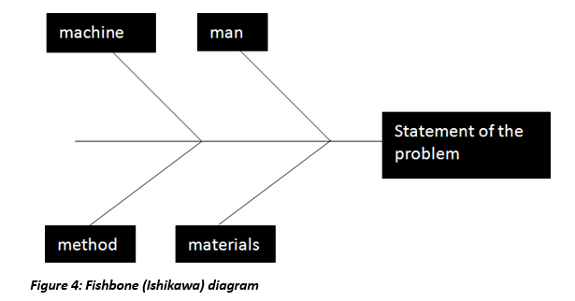
Fishbone (Ishikawa) diagram

Slide 17
Six thinking hats
Six Thinking Hats is a good technique for looking at the effects of a decision from a number of different points of view.
It allows necessary emotion and scepticism to be brought into what would otherwise be purely rational decisions. It opens up the opportunity for creativity within decision making
White Hat: With this thinking hat you focus on the data available. Look at the information you have, and see what you can learn from it. Look for gaps in your knowledge, and either try to fill them or take account of them. This is where you analyze past trends, and try to extrapolate from historical data.

Slide 18
RED Hats
Red Hat: ‘Wearing' the red hat, you look at problems using intuition, gut reaction, and emotion.
The red hat allows the free expression of feelings, intuition, hunches and emotions without apology and without explanation, there must never be any attempt to justify or give the basis for the feelings.
The red hat asks a person to express his or her feelings on the subject at this moment in time, it gives full permission to a thinker to put forward his or her feelings on the subject at the moment.

Slide 19
Black Hat
Using black hat thinking, look at all the bad points of the decision. Look at it cautiously and defensively.
Try to see why it might not work.
This is important because it highlights the weak points in a plan.
It allows you to eliminate them, alter them, or prepare contingency plans to counter them.
. It can also help you to spot fatal flaws and risks before you embark on a course of action.

Slide 20
Yellow Hat
The yellow hat helps you to think positively.
It is the optimistic viewpoint that helps you to see all the benefits of the decision and the value in it.
Yellow Hat thinking helps you to keep going when everything looks gloomy and difficult.

Slide 21
Green Hat:
The Green Hat stands for creativity.
This is where you can develop creative solutions to a problem. It is a freewheeling way of thinking, in which there is little criticism of ideas.
A whole range of creativity tools can help you here.
Under the green hat, we put forward alternatives, seek out new ideas, modify and change suggested ideas, use provocations and movement to produce new ideas, generate possibilities

Slide 22
Blue Hat:
‘Blue Hat Thinking' stands for process control.
This is the hat worn by people chairing meetings.
It is concerned with defining the problem and what is being thought about. It also concerns with:
Outcomes, Conclusions, Summaries and what happens next. Blue hat is the organizer of the thinking process.

Slide 23
IDEA SELECTION
There are several methods to select ideas. Instead of basing selection on arbitrary decisions, it is recommended to apply a set of business criteria to the idea and rank how well the idea meets each criterion.
If an idea achieves a sufficiently high ranking, either as is or through additional modification, it should be developed further.
IDEA IMPLEMENTATION
Ideas that have passed successfully testing and development criteria, are ready to be implemented. Now, you can integrate the innovation into your ongoing routine, production activity, etc.

Slide 24
Innovation Management Process
1. Planning (Innovation Plan)
2. Project management
3. How to finance innovation
4. Managing the context -
Competitive intelligence, technological watch and benchmarking

Slide 25
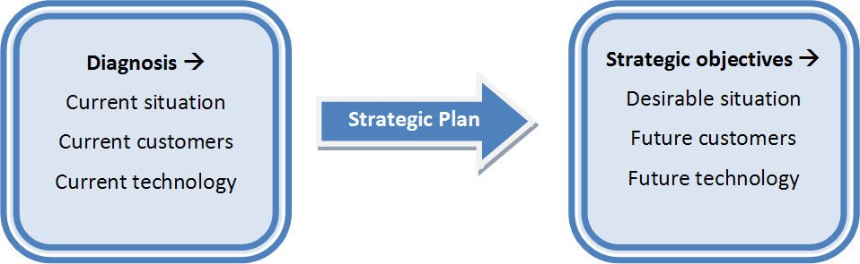
1. Planning
Innovation process is based on detect potential innovations, process these signals and develop the capacity to change and take advantage of them.
Once you have processed, assimilated and selected the most significant of them, they must be concatenated in a strategic plan.
The strategic plan will define the better way to achieve the desirable situation.

Slide 26
2. Project Management
Project management: The discipline that deals with organises and administrates resources in order to complete all work required in the project within scope, time and cost defined.
Projects are supportive of overarching strategic objectives of the company and of development partners
Projects are feasible, meaning that objectives can be realistically achieved within the constraints of the operating environment and capabilities of the company
Improve and optimize future planning

Slide 27
3. How to finance innovation
In addition to the usual financial resources available in the company, it is possible to access to various grants, subsidies and other instruments that some public bodies and institutions provide.
Financing instruments:
Subsidies (National, regional and local programmes)
Credits
Participative loans
Venture capital
Tax incentives

Slide 28
4. Managing the context
Environment
Innovation is not an isolated process, the interaction among the stakeholders shapes the outcome of the innovation process.
The environment of the innovative enterprise is formed by universities, specialized technical training, scientific and researcher community, common funds of knowledge, human resources, internal effort and policies, and support of public administrations and other organisations.

Slide 29
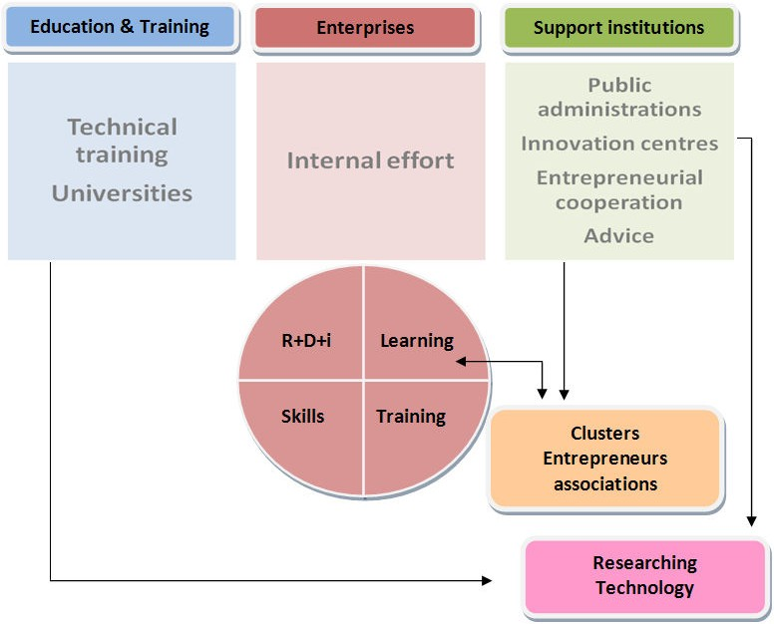

Slide 30
Nevertheless, there are other factors with significant importance in the environment of an innovative enterprise, as innovation policies of national/local governments, macroeconomic and legislative context, communications infrastructures, financial institutions, access to markets, or industrial structure and competitiveness conditions
Effective benchmarking, competitive intelligence, technological watch can be implemented to know the environment better.

Slide 31
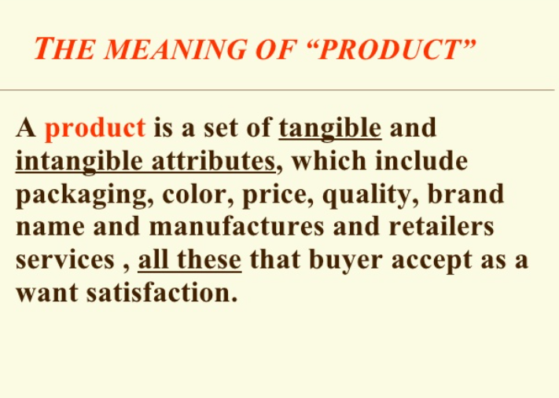
NEW PRODUCT DEVELOPMENT

Slide 32
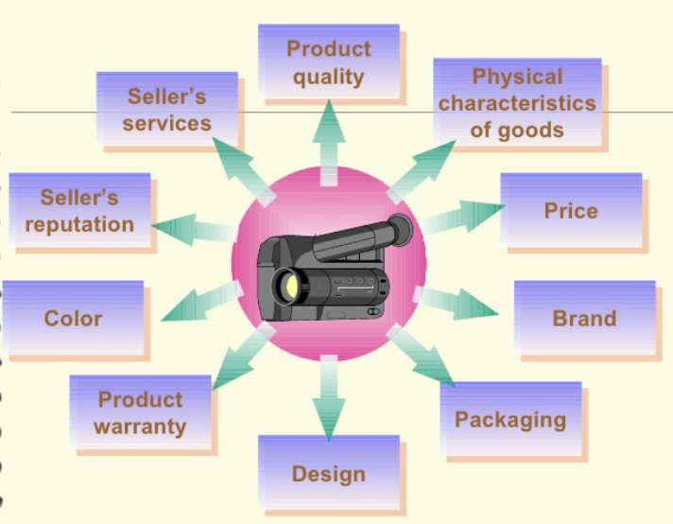

Slide 33
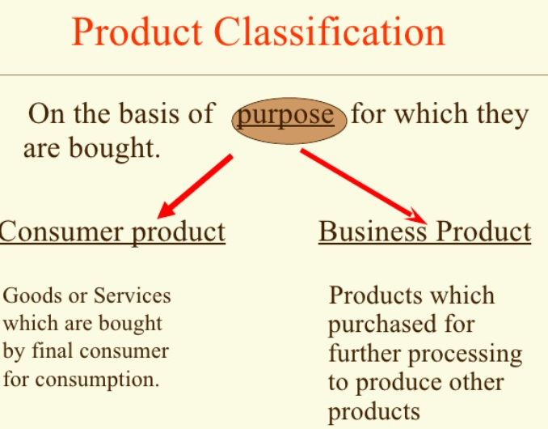

Slide 34
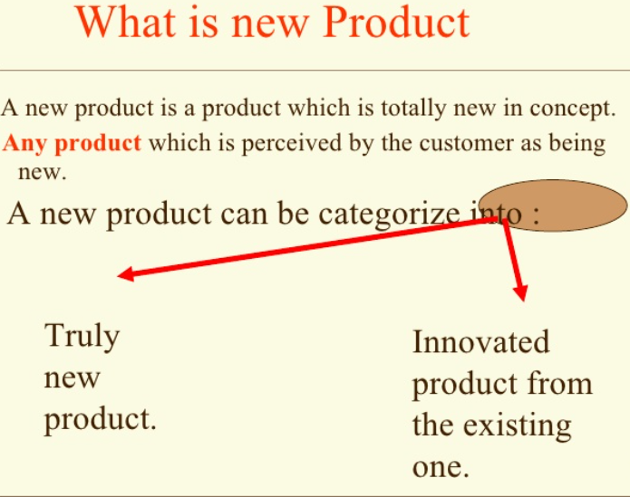

Slide 35
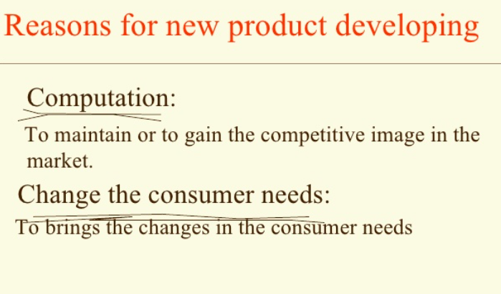

Slide 36
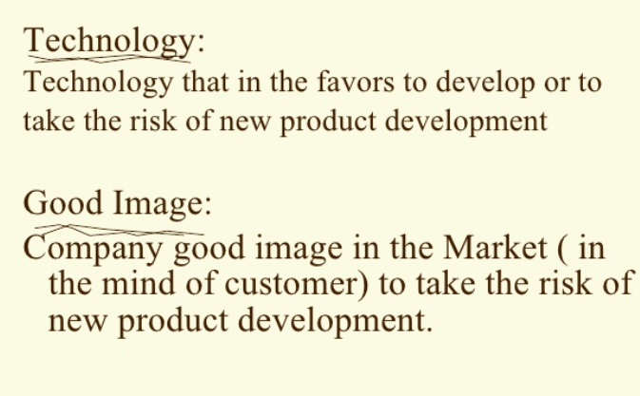

Slide 37
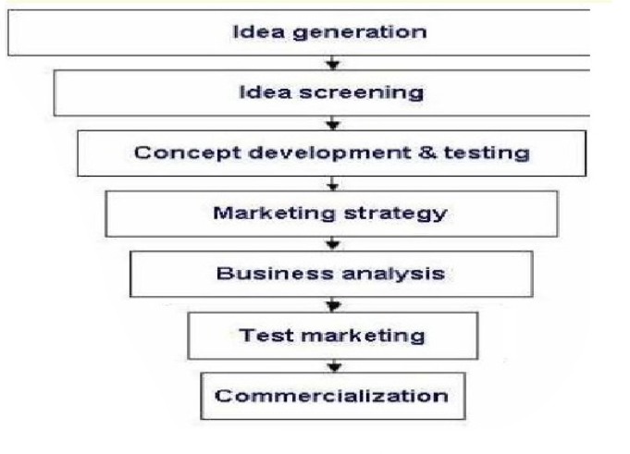
NEW PRODUCT DEVELOPMENT PROCESS

Slide 38
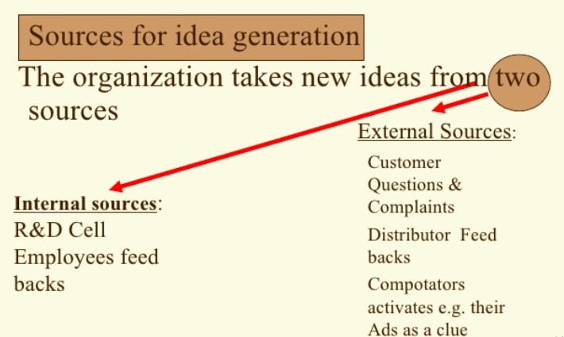
Competitors Activities

Slide 39
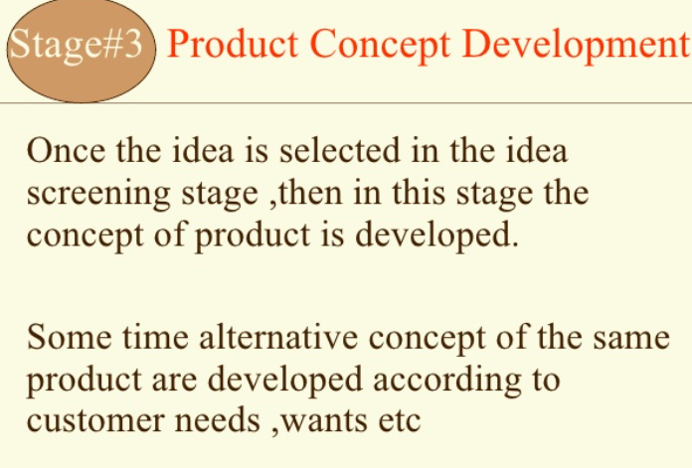
Stage 2—Idea Screening
Utilization
Resources
Ethical aspect

Slide 40
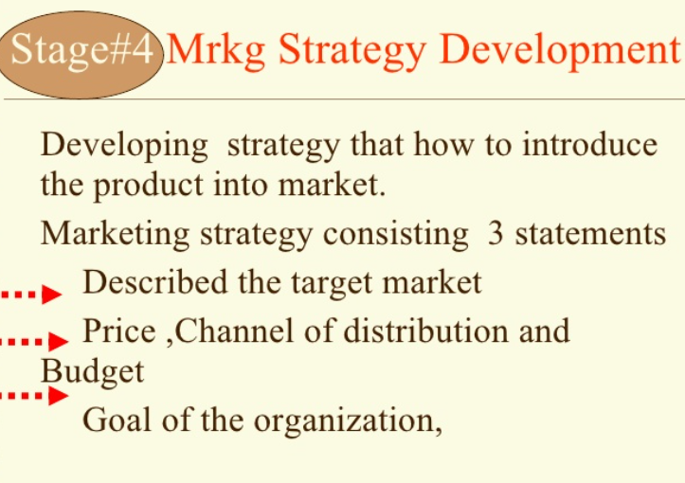

Slide 41
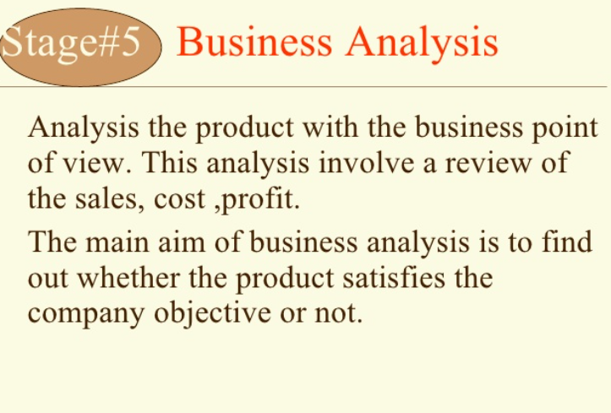

Slide 42
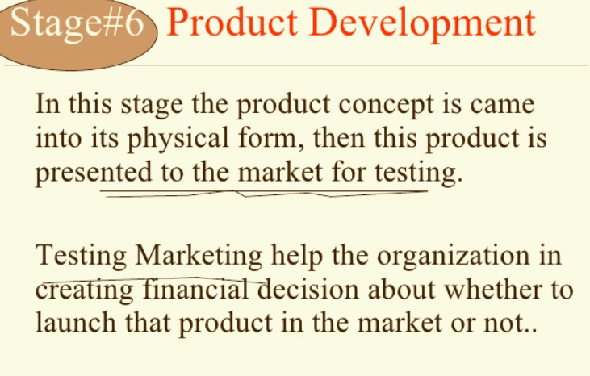

Slide 43
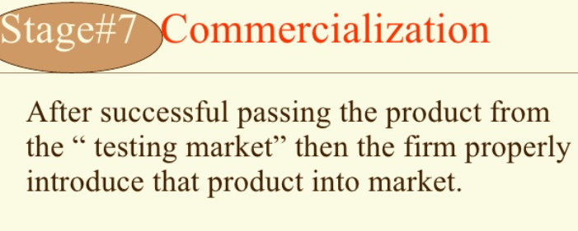

Slide 44
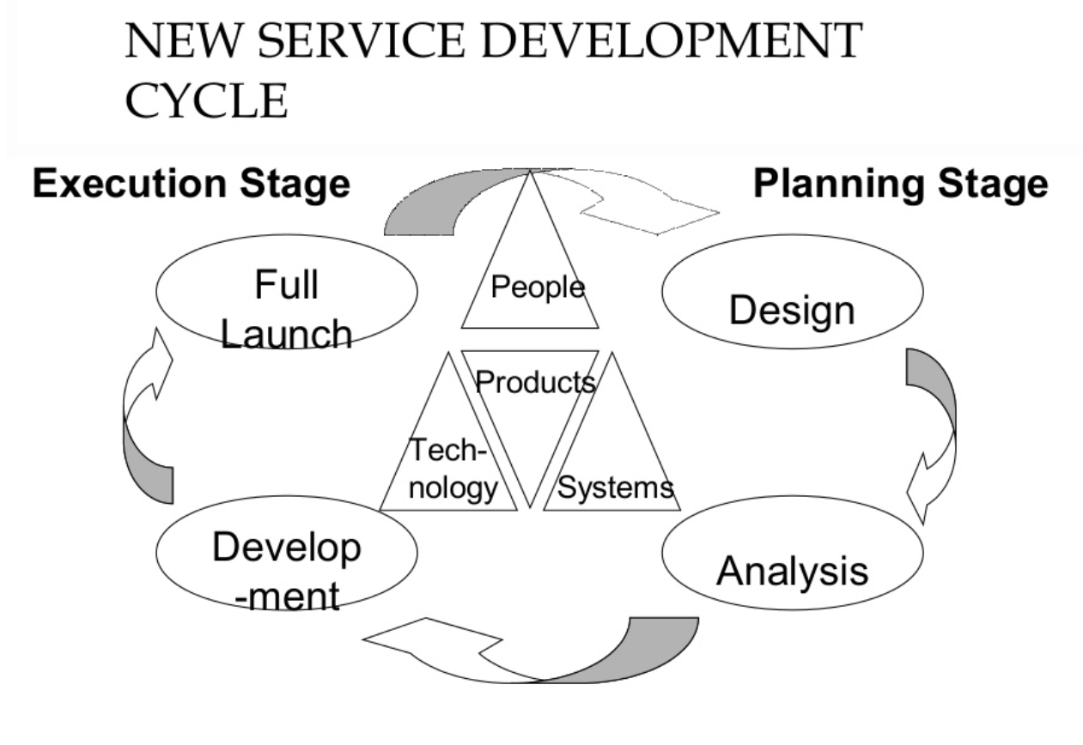

Slide 45
OPEN INNOVATION AND COLLABORATION
It is defined as a paradigm shift in innovation management that emphasizes the importance of leveraging external sources of knowledge, ideas, and technologies in addition to internal R&D capabilities.

Slide 46
COMPONENTS OF OPEN INNOVATION
External Knowledge Sourcing: It involves actively seeking and incorporating external ideas, technologies, and partnerships into the innovation process.
Collaborative Networks: Open innovation encourages collaboration with a diverse range of stakeholders, including customers, suppliers, competitors, research institutions, and startups. inbound and Outbound Flows: Inbound flows involve the absorption of external ideas and technologies, while outbound flows involve the commercialization and dissemination of internal innovations to external partners.
Openness and Transparency: Open innovation emphasizes the importance of being open and transparent in sharing knowledge and ideas with external partners.
Flexible Organizational Boundaries: Organizations may engage in strategic alliances, joint ventures, licensing agreements, or crowdsourcing initiatives to access external resources and expertise.

Slide 47
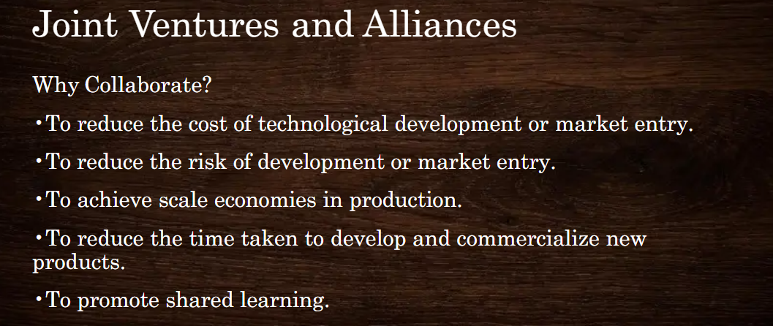

Slide 48
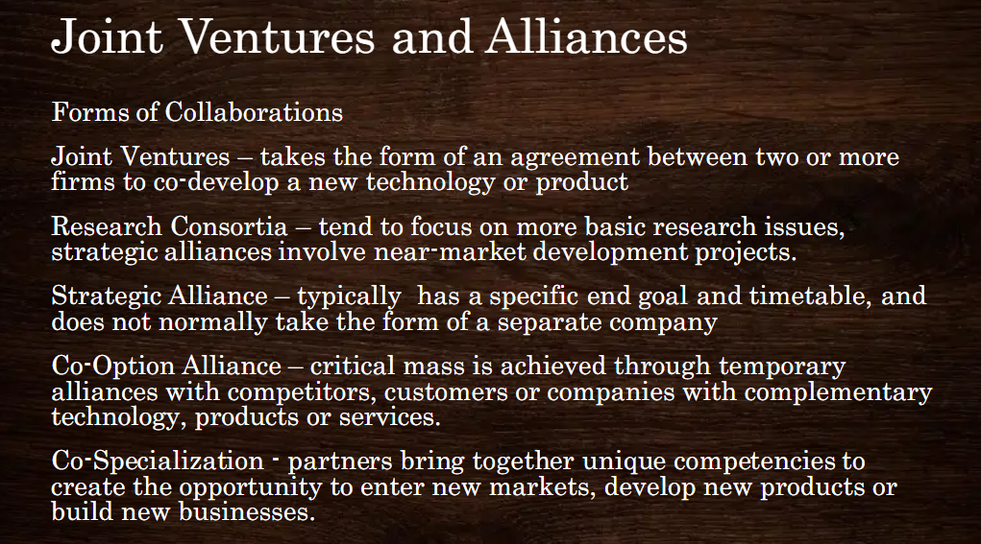

Slide 49
EXAMPLES
Joint Venture - Toyota and Tesla Motors to develop electric vehicles (EVs).

Slide 50
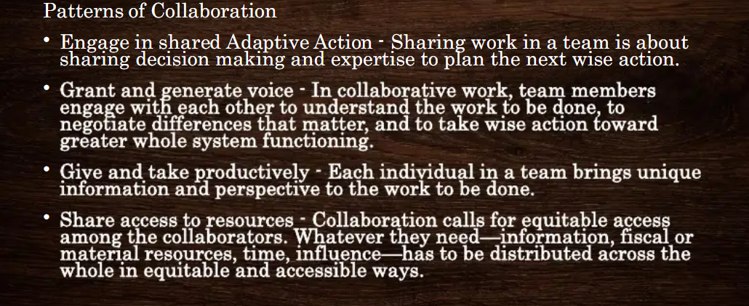

Slide 51
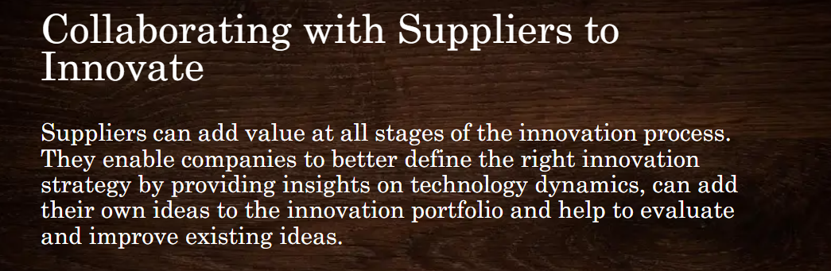


Slide 52


Slide 53


Slide 54


Slide 55
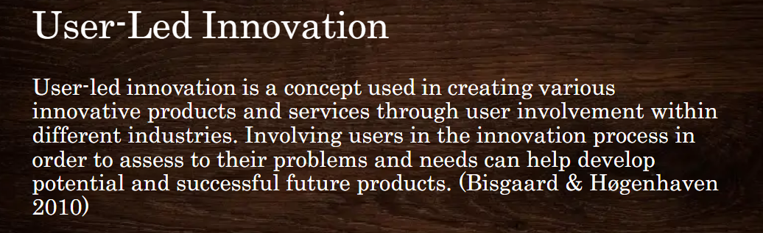

Slide 56
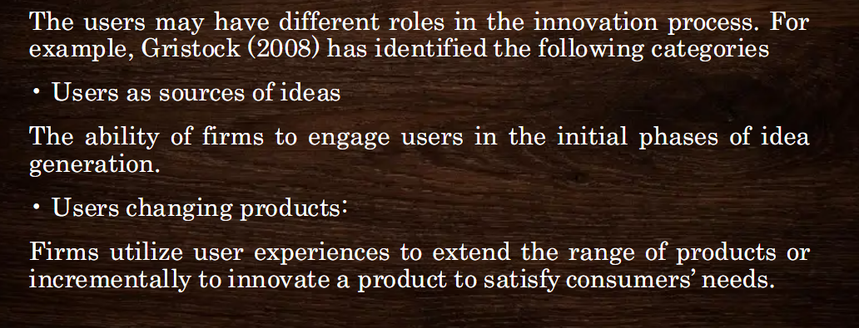
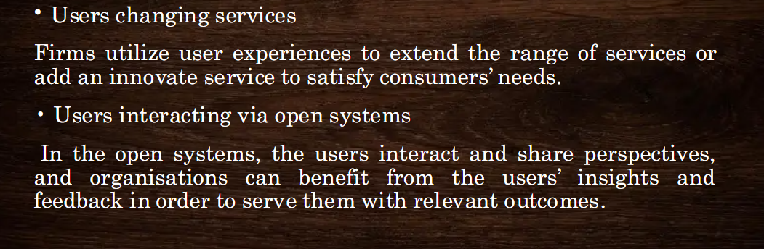

Slide 57
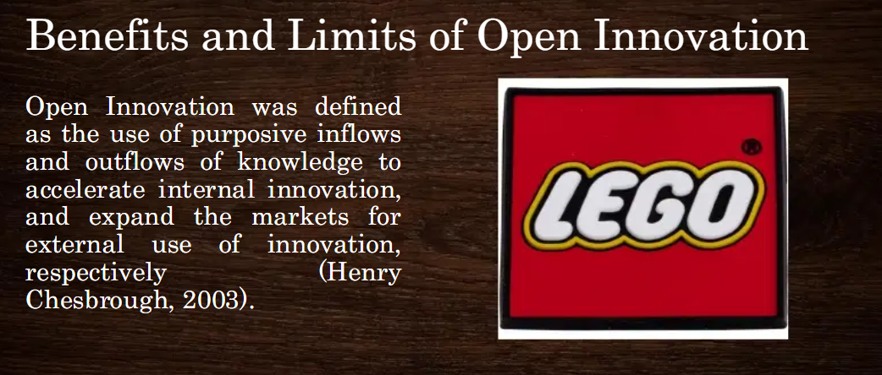

Slide 58
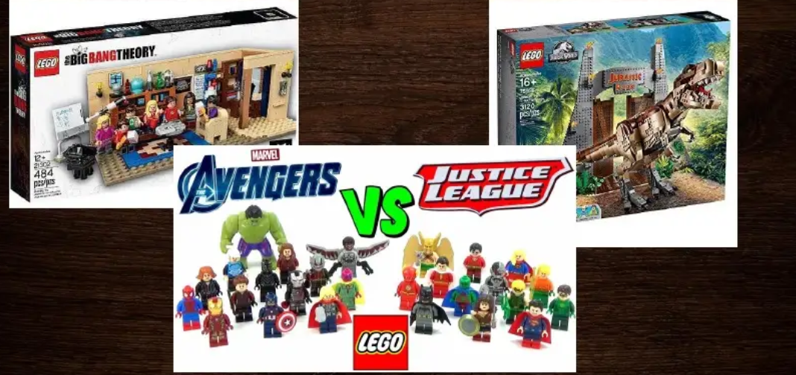

Slide 59
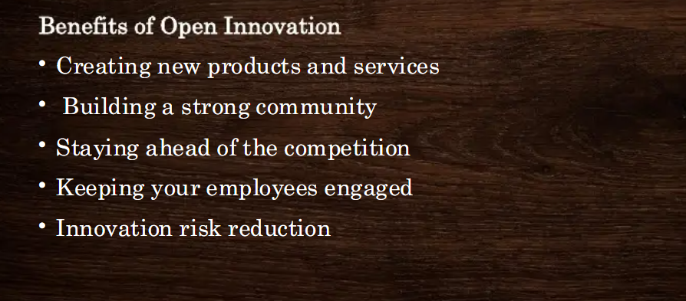

Slide 61
Core themes
• Joint ventures and alliances
• Role of supplier innovation
• Forms and patterns of collaboration
• Influence of technology and organization
• Supplier collaboration
• User-led innovation
• Extreme users
• Benefits and limitations of open innovation

Slide 62
Joint ventures and strategic alliances
A joint venture is the association of two or more business entities forming a separate legal entity to carry out continued business operations.
BMW and Toyota co-operate on research into hydrogen fuel cells and ultra-lightweight materials. Google and NASA developing Google Earth.
A strategic alliance is an agreement between two or more entities working jointly with one another to enhance the businesses of each other.

Slide 63
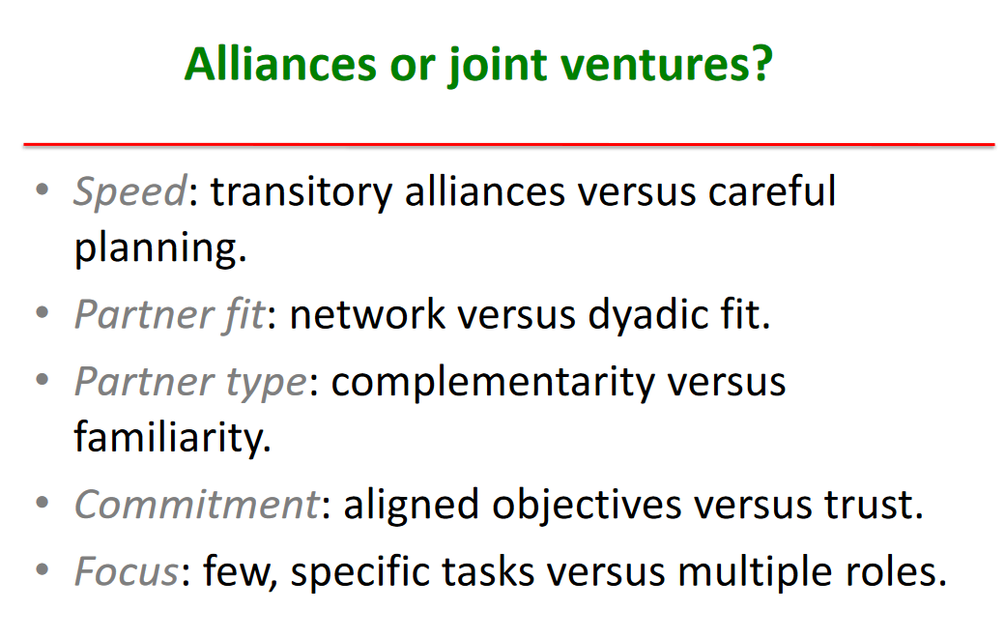

Slide 64
Obtain technology
Access to markets
Strategic
Alliance
Reduce financial risk
Reduce political risk
Achieve competitive
advantage

Slide 65
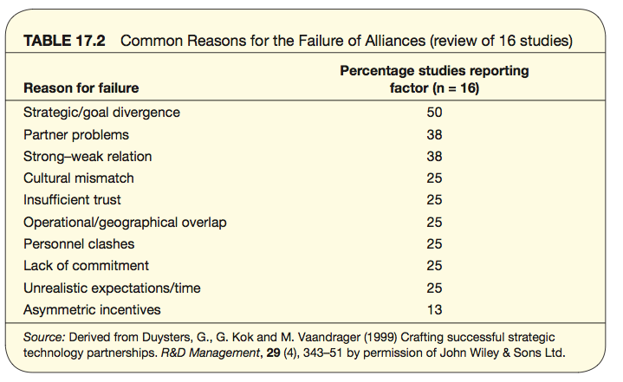
Why alliances fail

Slide 66
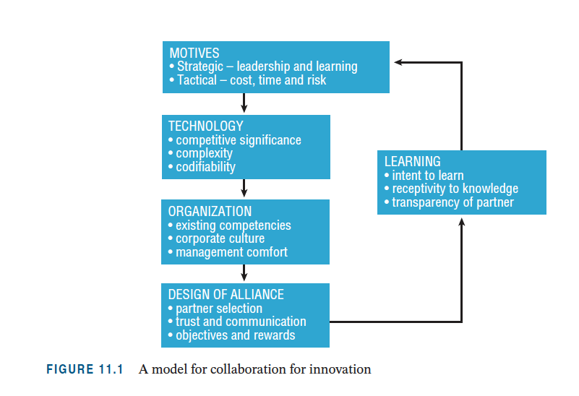
A model for collaboration

Slide 67
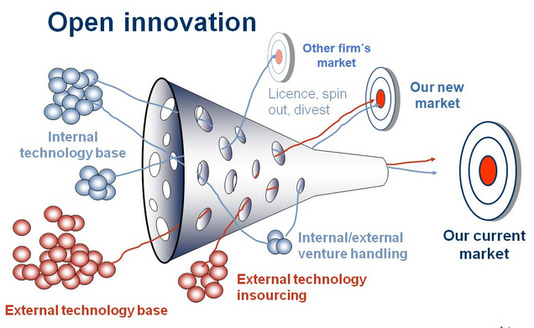
Open innovation

Slide 68
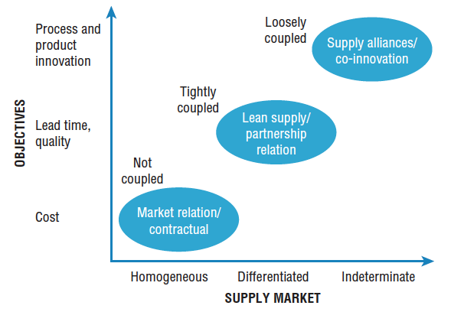
Supplier relationships

Slide 69
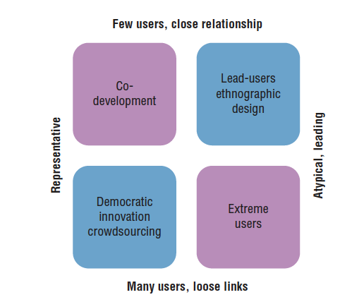
Types of user innovation

Slide 70
Challenges in open innovation
• conditions and context, e.g. environmental uncertainty and project complexity
• control and ownership of resources
• coordination of knowledge flows
• creation and capture of value.

Slide 71
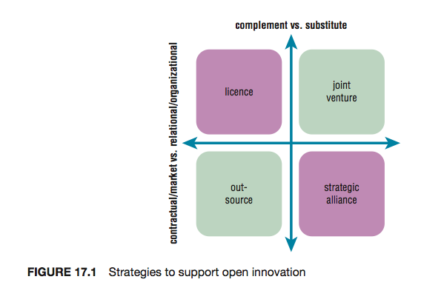
Strategies to support open innovation

Slide 72
Summary
Organizations collaborate for many reasons, to reduce the cost, time or risk of access to unfamiliar technologies or markets.
The precise form of collaboration will be determined by the motives and preferences of the partners, but their choice will be constrained by the nature of the technologies and markets, specifically the degree of knowledge complexity and tacitness.

Slide 73
Summary
The success of an alliance depends on a number of factors, but organizational issues dominate, such as the degree of mutual trust and level of communication.
Open innovation is a very broad and therefore popular concept, but needs to be applied with care as its relevance is sensitive to the context. The appropriate choice of partner and specific mechanisms will depend on the type of innovation project and environmental uncertainty.

Slide 74
Summary
In most cases open innovation and internal innovation capabilities are complementary, rather than substitutes.

